Slide 1
UNIT-2
TOPIC- motivation
(B.Com. (2nd sem.)
Presented by:
Aakansha Dahiya
Assistant Professor
Kanya Mahavidyalaya, Kharkhoda

Slide 2
Definition and Meaning of Motivation
‘Motivation’ is the process of inspiring people in order to intensify their desire and willingness for executing their duties effectively and for co-operating to achieve the common objectives of an enterprise.
In other words, it means to induce, instigate, incite or prompt someone to a particular course of action for getting the results expected from him.

Slide 3
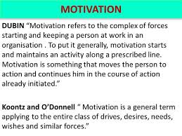

Slide 4
THEORIES OF MOTIVATION
Maslow's hierarchy of needs
Herzberg's motivator-hygiene theory
McGregors’ X and Y theory
Ouchis’ Z theory

Slide 5
MASLOW ‘S THEORY OF MOTIVATION
We each have a hierarchy of needs that ranges from "lower" to "higher." As lower needs are fulfilled there is a tendency for other, higher needs to emerge.”
Maslow’s theory maintains that a person does not feel a higher need until the needs of the current level have been satisfied.

Slide 6
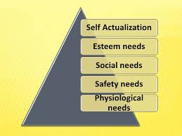

Slide 7
Physiological Motivation: Provide ample breaks for lunch , pay salaries that allow workers to buy life's essentials.
Safety Needs: Provide a working environment which is safe, relative job security, and freedom from threats.
Social Needs: Generate a feeling of acceptance, belonging by reinforcing team dynamics.

Slide 8
Esteem Motivators: Recognize achievements, assign important projects, and provide status to make employees feel valued and appreciated.
Self-Actualization: Offer challenging and meaningful work assignments which enable innovation, creativity, and progress according to long-term goals.

Slide 9
LIMITATIONS AND CRITICISM
Maslow’s hierarchy makes sense but little evidence supports its strict hierarchy. Research has challenged the order imposed by Maslow’s pyramid. As an example, in some cultures, social needs are regarded higher than any others.
Little evidence suggests that people satisfy exclusively one motivating need at a time.

Slide 10
HERZBERG'S MOTIVATION-HYGIENE THEORY
Frederick Herzberg performed studies to determine which factors in an employee's work environment caused satisfaction or dissatisfaction. He published his findings in the 1959 book The Motivation to Work.

Slide 11
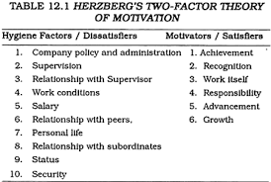

Slide 12
APPLYING IN BUSINESS
MANAGEMENT
According to Herzberg: The job should have sufficient challenge to utilize the full ability of the employee.
Employees who demonstrate increasing levels of ability should be given increasing levels of responsibility.
If a job cannot be designed to use an employee's full abilities, then the firm should consider automating the task or replacing the employee with one who has a lower level of skill. If a person cannot be fully utilized, then there will be a motivation problem

Slide 13
LIMITATION AND CRITICISM
Critics consider Herzberg's two factor theory to be simplistic - what motivates me may be a dissatisfier for someone else.
Its for individuals, not as a homogeneous group with one set of wants and needs.
Some factors may be within your control, some may not.

Slide 14
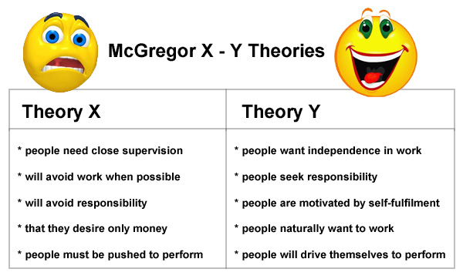

Slide 15
Ouchis’ Z Theory
William Ouchi developed Theory Z after making a comparative study of Japanese and American management practices. Theory Z is an integrated model of motivation. Theory Z suggests that large complex organisations are human systems and their effectiveness depends on the quality of humanism used. A type Z organisation has three major features—trust, subtlety and intimacy.

Slide 16
The distinguishing features of Theory Z are as follows:
1. Mutual Trust
2. Strong Bond between Organisation and Employees
3. Employee Involvement
4. Integrated Organisation
5. Coordination

Slide 17
Theory Z suffers from the following limitations:
It merely provides job security and may fail to develop loyalty among employees.
Participation of employees in the decision-making process is very difficult.
Theory Z suggests organisation without any structure.
The theory may not be applicable in different cultures.

Slide 18
THANK YOU….FOR YOUR MOTIVATION

